Slide 1

Exploratory Data Analysis
G2M Analysis for Investment in cab companies
Sept 14, 2023

Slide 2

Agenda
Background
Approach
EDA
Recommendations

Slide 3
Background
XYZ, a private equity firm, is looking to venture into the fast-growing cab industry
Data is analyzed for 2 potential investments- Pink Cab & Yellow Cab
Different customer aspects analyzed to gain insights on best investment choice
Data Sources:
Cab Data
Customer ID
Transaction ID
City
Data Period:
Jan 31, 2016 to Dec 31, 2018
Data Exploration:
Each dataset was examined for the data structure, presence of missing (NaN) values and duplicates.

Slide 4
Approach
Creating an applicable dataset:
Imported necessary libraries
Merged relevant datasets into a master dataset
Removed missing values
Converted TravelDate to a DateTime format
Removed outliers
Data Preparation & Analysis:
Data Cleaning
Exploratory Data Analysis
Descriptive Data Visualization
Comparative Analysis
Reason for this approach:
To gain meaningful insights from datasets
For investigating specific relevant questions
For comparison of metrics against various factors

Slide 5
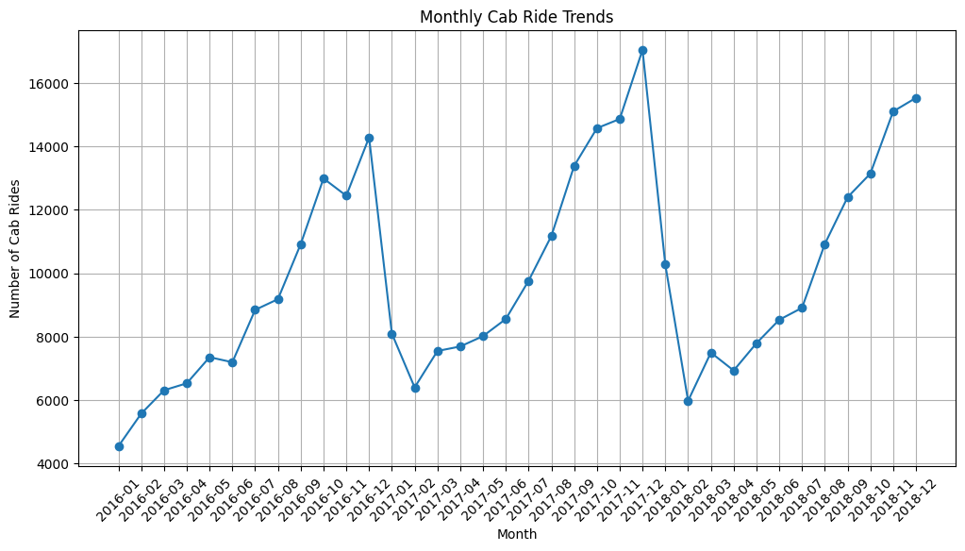
EDA
Steady, somewhat predictable cycle & seasonality in the industry = less investment risk

Slide 6
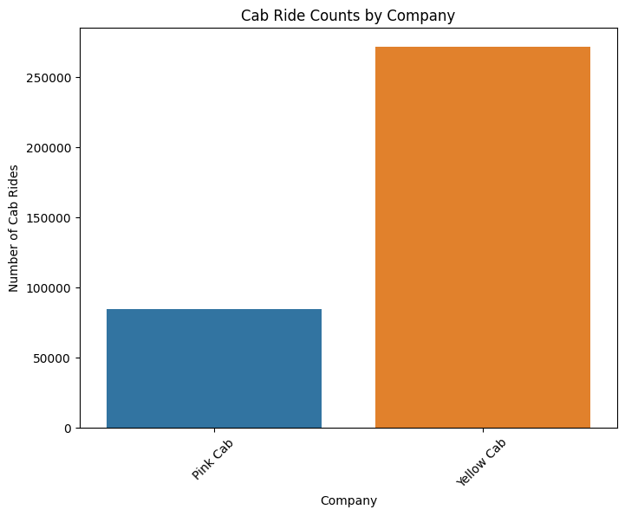
EDA
Yellow Cab seems to be dominating the market with over 2x Market Capitalization compared to Pink Cab

Slide 7
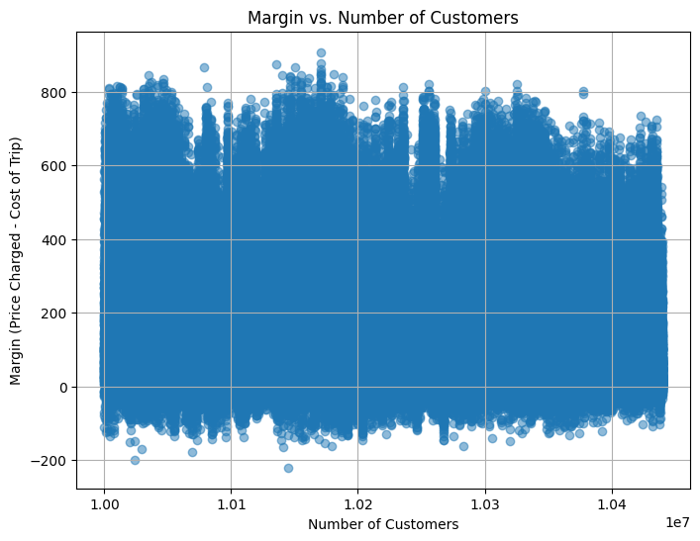
EDA
The relationship between the margin (the profit earned from cab rides) and the number of customers. Each point represents a cab ride transaction

Slide 8
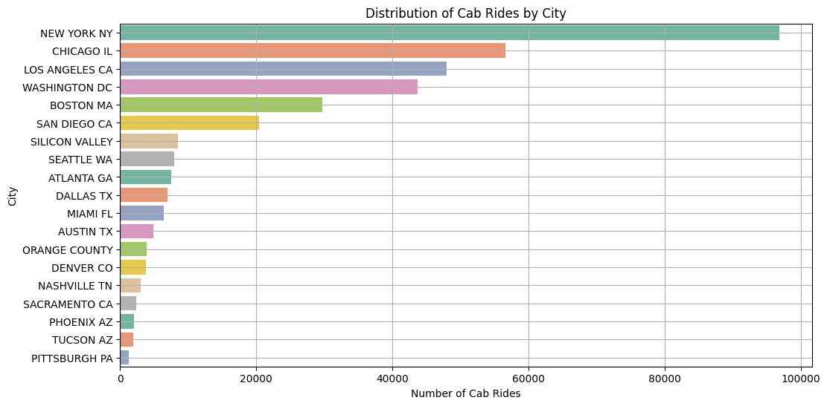
EDA
Two densely populated major markets on each (East & West) coast.

Slide 9
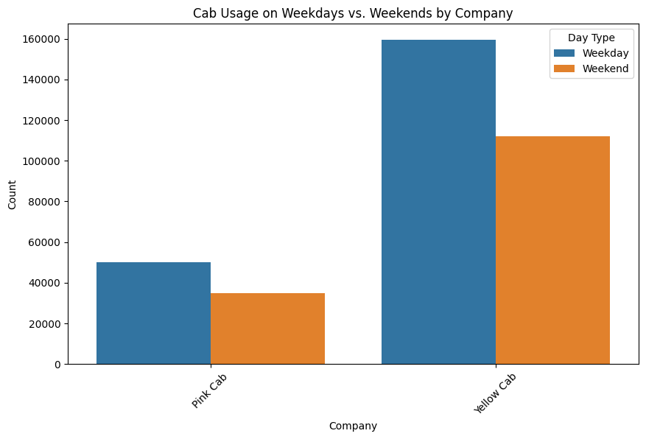
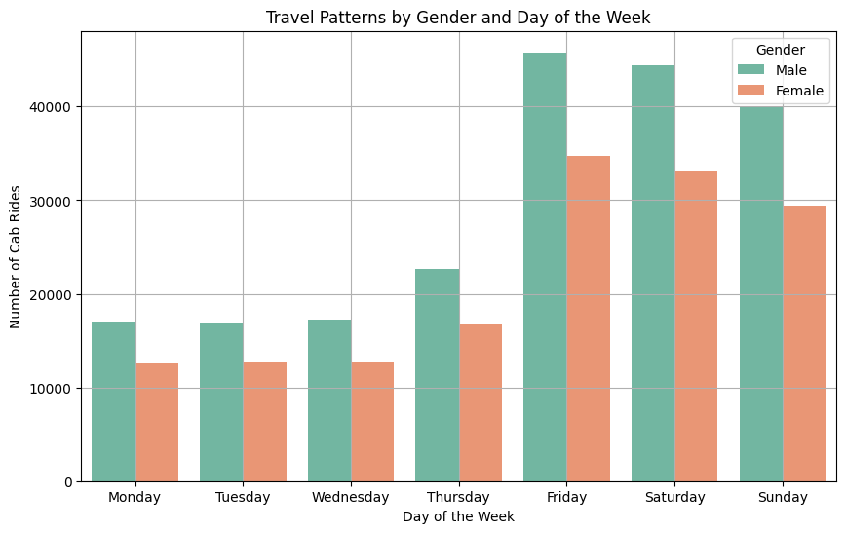
EDA
Cab usage patterns between weekdays and weekends for both companies, which can be valuable for making business decisions
The number of cab rides taken by males and females on each day of the week

Slide 10
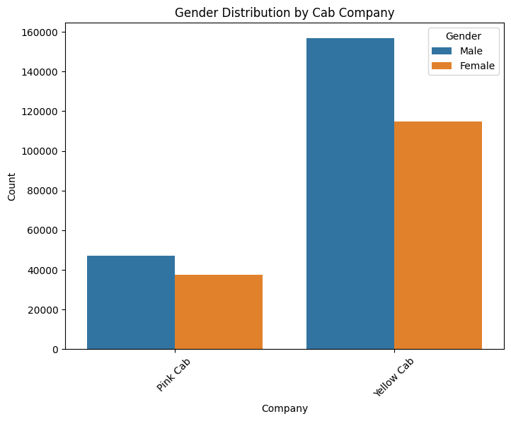
EDA
The proportion of male and female customers for Pink Cab and Yellow Cab

Slide 11
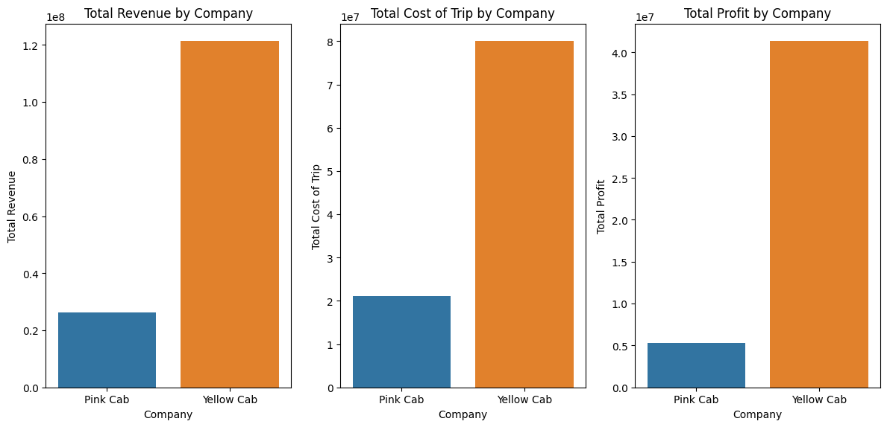
EDA
Yellow cab is generating higher revenue & profits while Pink cab has higher costs resulting in lower total profits

Slide 12
Recommendations
Based on the extensive analysis conducted, including seasonal trends, company performance, and customer segments, it is recommended that XYZ consider investing in Yellow Cab.
Company Performance: Yellow Cab has consistently outperformed Pink Cab in terms of total revenue and profit. This indicates better investment potential for XYZ.
Market Dominance: Yellow Cab's market capitalization is over 2 times that of Pink Cab, indicating a dominant presence in the market.
Profitability: Despite higher costs, Yellow Cab manages to generate higher total profits compared to Pink Cab.
Market Insights: The analysis provides valuable insights into seasonal variations in cab usage and customer behavior, which can be leveraged for strategic decisions.
Risk Mitigation: The somewhat predictable cycle and seasonality in the industry suggest lower investment risk in Yellow Cab.
Overall, the data-driven analysis supports the hypothesis that Yellow Cab presents a stronger investment opportunity for XYZ in the cab industry.

Slide 13
Thank You

